Slide 1
Coral Outplanting Activity

Slide 2
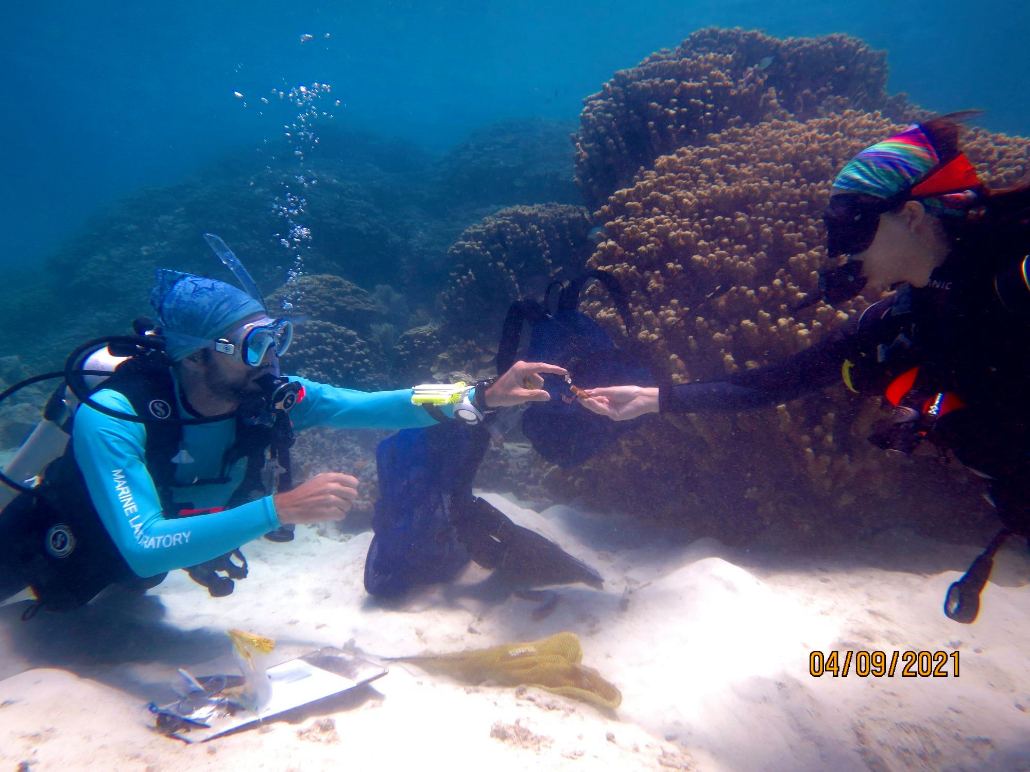
Writing underwater!
Notes:
Information collector

Slide 3
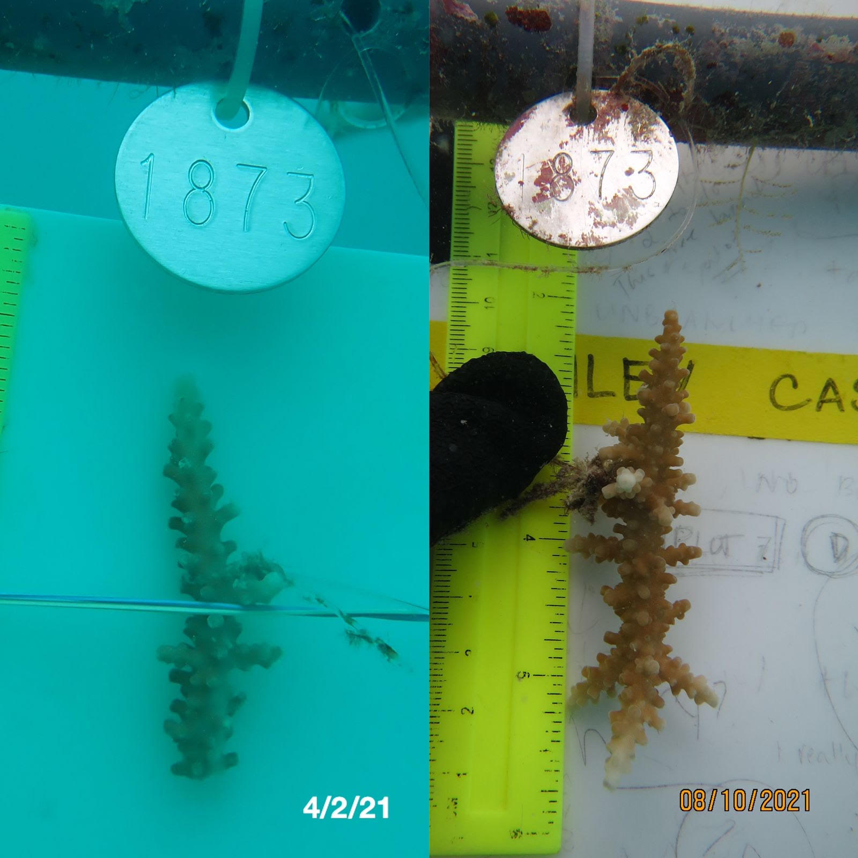
Coral on Day 1
Same coral after 4+ months
Notes:
Coral measurer

Slide 4
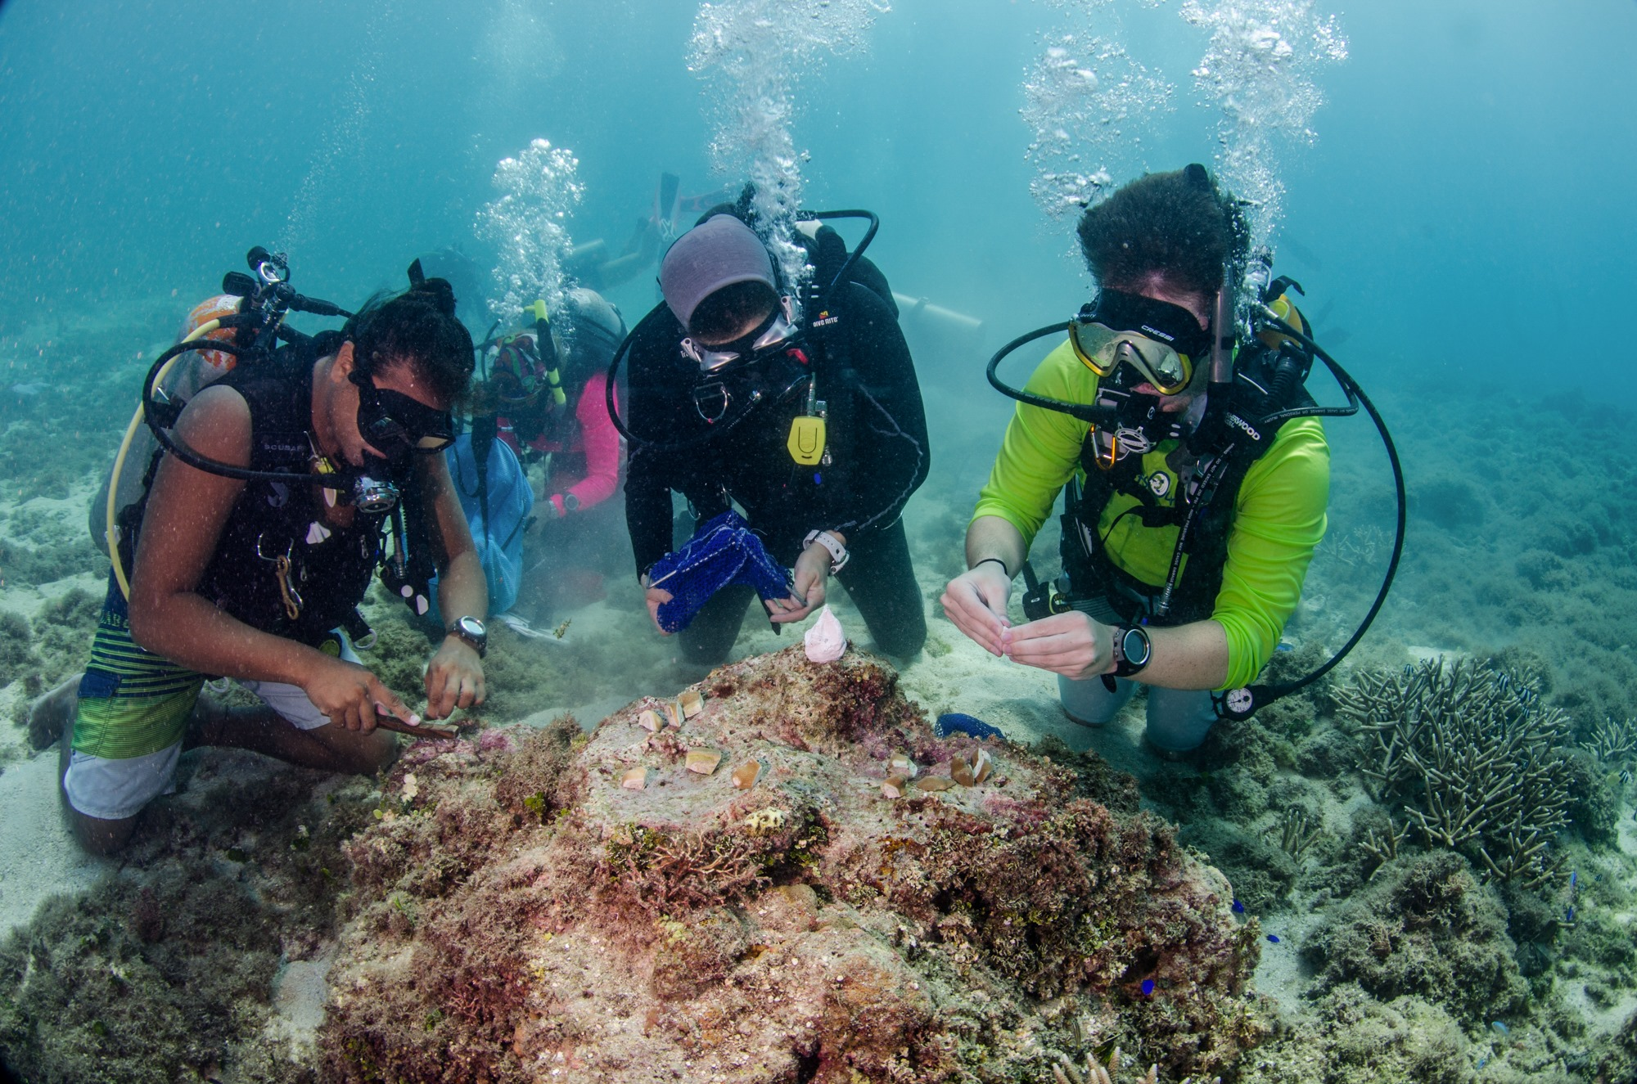
Scrubber
Notes:
Scrubber – clearing the area of sand and dirt so that coral fragment can stick to the surface.

Slide 5
Notes:
Closer look at scrubbing

Slide 6
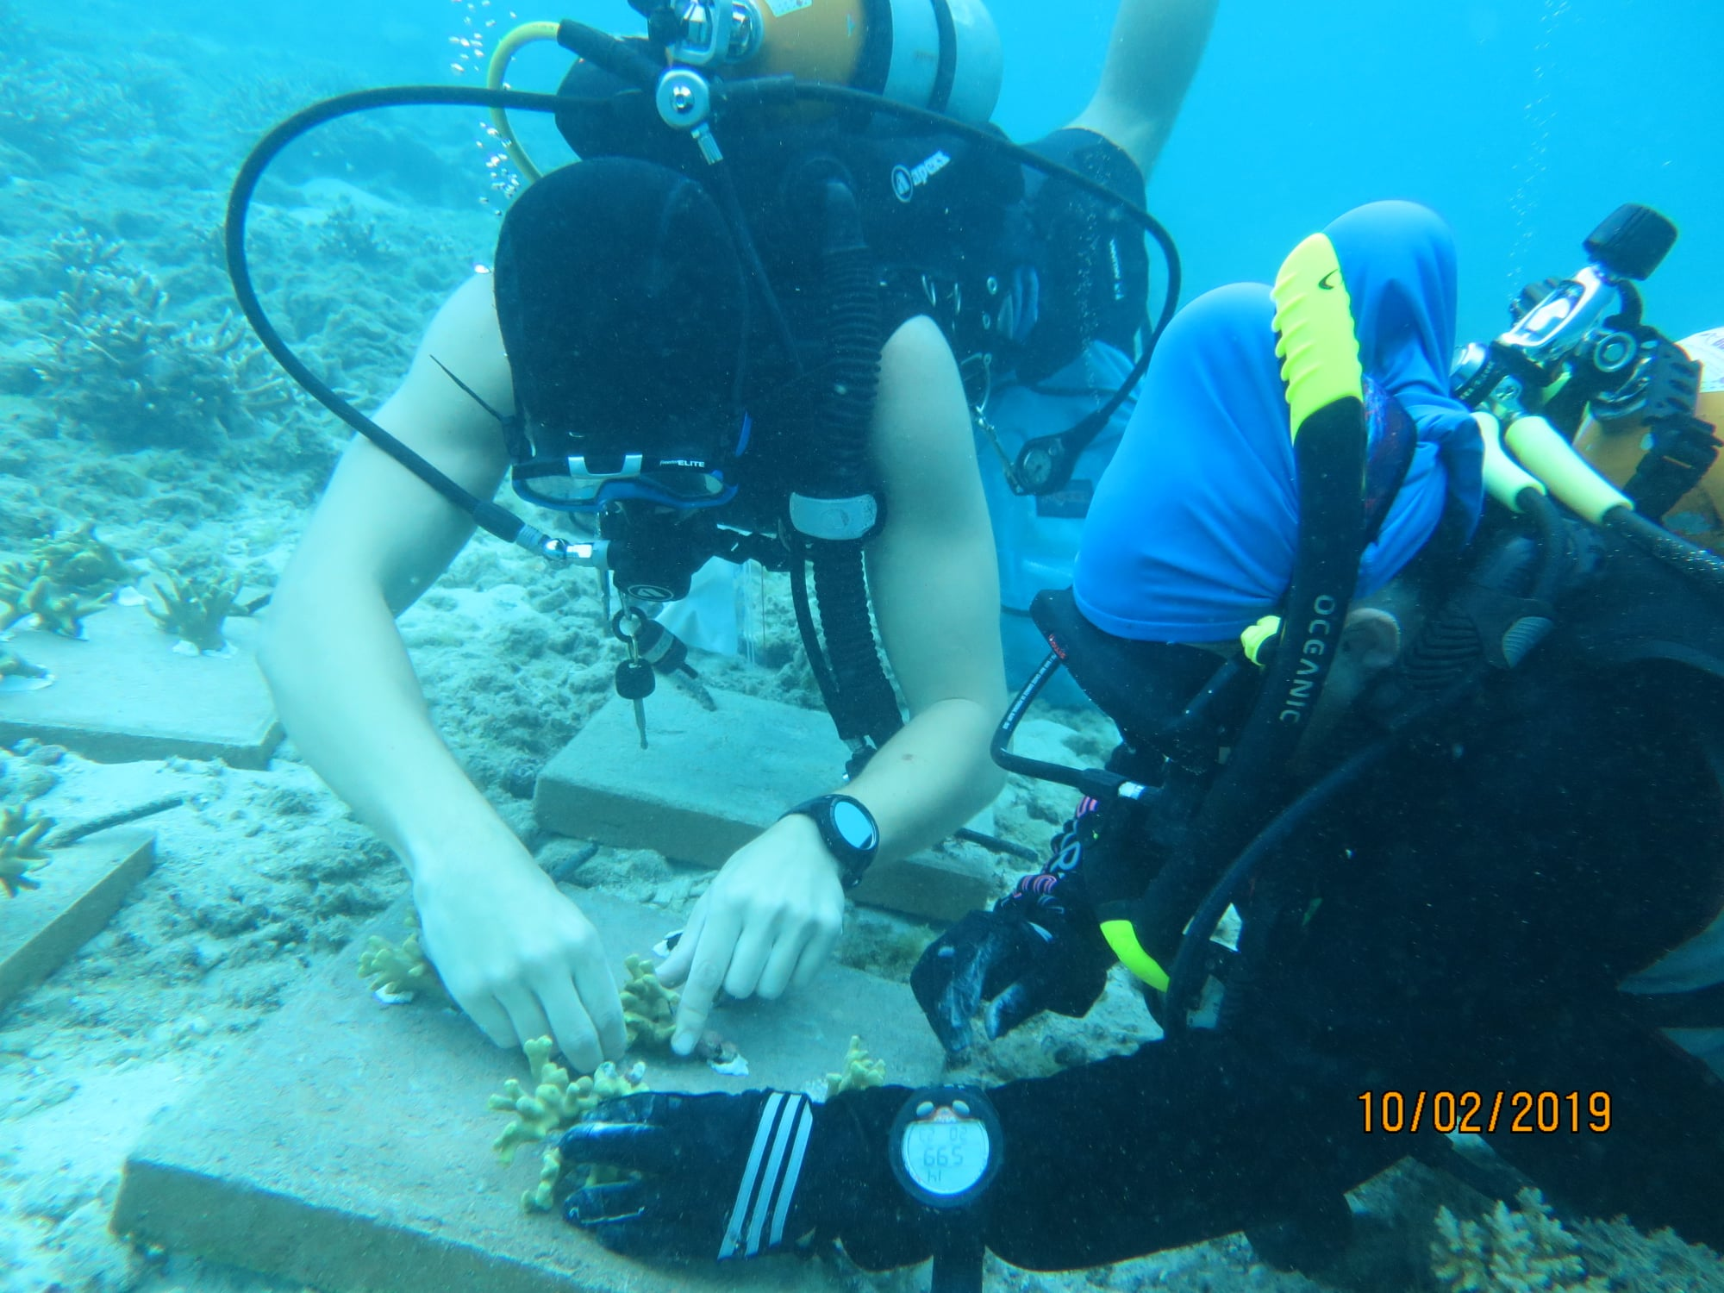
Coral Gluer
Notes:
Coral gluer

Slide 7
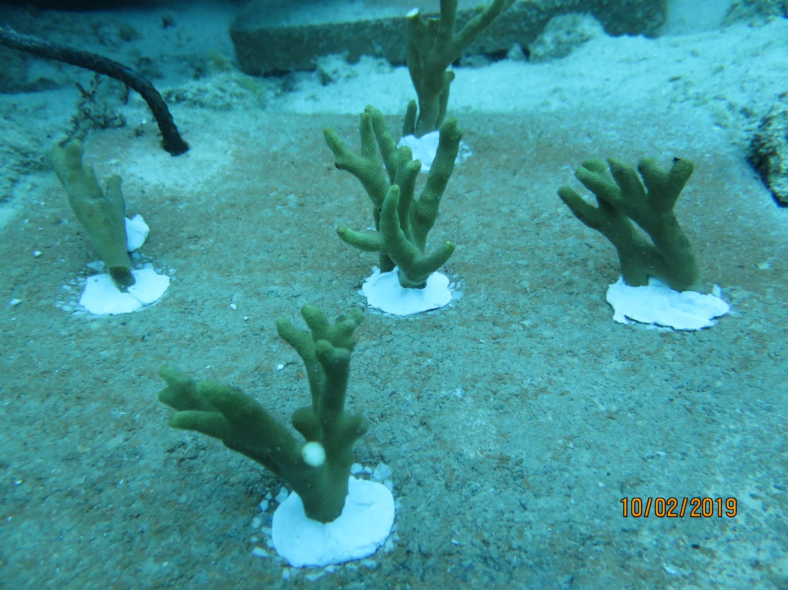
Coral fragment
Glue
Notes:
Closer look at glued coral frags

Slide 8
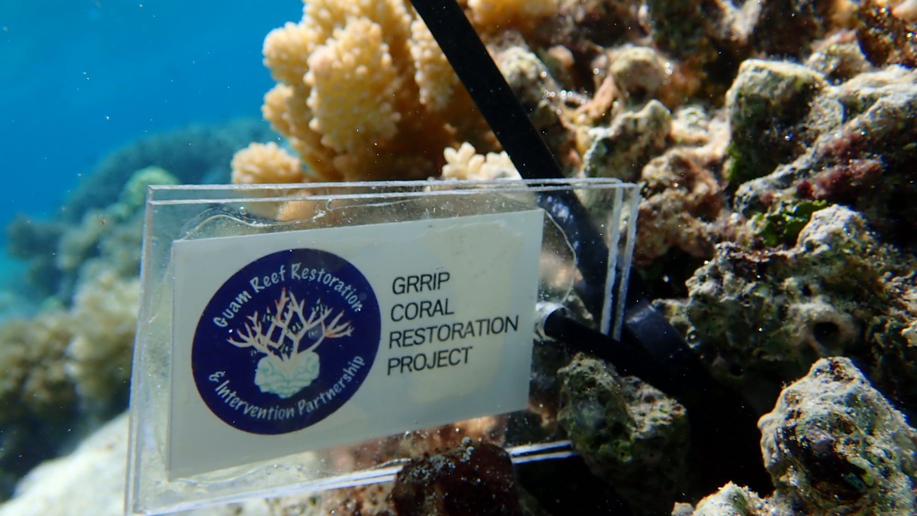
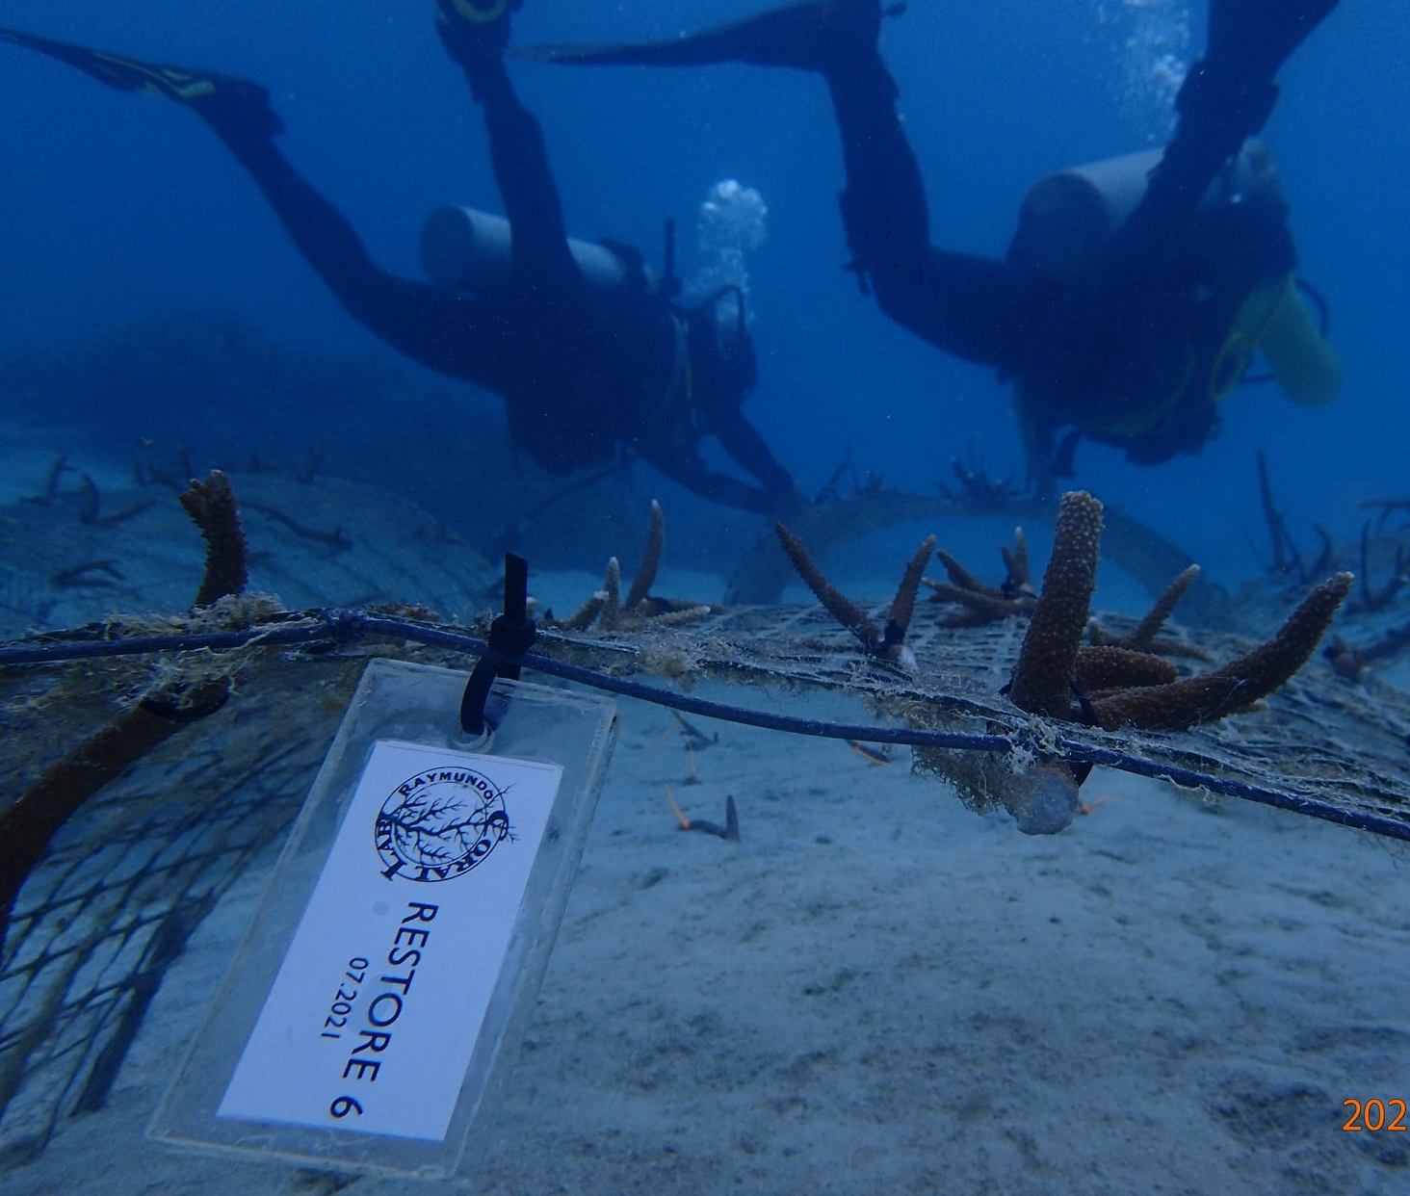
Labeled coral fragments
Notes:
Coral labeler – group name, date, coral name

Slide 9
Team Roles
Writer
Coral Measurer
Scrubber
Coral Labeler
Coral Gluer

